Slide 1
A Genetic Algorithm for Prioritized Package Delivery
Zonghui Hu, Zichen Yang
05/14/2023

Slide 2
Overview
Problem Definition
Literature Survey
General Pipeline
Dijkstra’s Algorithm
Genetic Algorithm
Experiments & Results
Conclusion

Slide 3

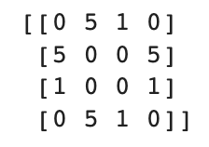
Problem Definition
Given Topology, postmen, prioritized demands, and regulated time, how to deliver all packages with minimum cost?
Three Different Postmen:
Three Demands:
10
1
10
0
3
Speed Matrix, initial cost
Three packages needed to be delivered from node 0 to node 1, 3, and 2.
10
2
10
Regulated Time: 10 minutes
Overtime penalty: 10 per minute
, C = 10
Total Cost = Sum of Overtime penalty + Sum of postmen costs.

Slide 4
Feasible Solution Format
Any given list S satisfies following conditions is a feasible solution:
len(S) = len(Demands)
S[i] should be in the range of postman sequence number.
Use this property to randomly produce the solutions and form the initial population.
Feasible Solution could be:
[0,0,0]
[0,0,1]
[0,1,2]
[1,2,2]
……
10
1
10
3 postman, 3 demands
0
3
10
2
10

Slide 5
Problem Complexity
Both Path-Routing and package assignment problem are NP-Hard.
Path-Routing has O(n!) time complexity, where n is the number of cities.
Package assignment has O(p^{d}) time complexity, where p is the number of postmen, and d is the number of demand.
Heuristic Algorithm sacrifices the optimality of the solution for computational efficiency. Though it may produce a solution that is not guaranteed to be optimal, it is often sufficient for practical purposes.

Slide 6
Literature Survey
Numerous research study the feasibility of heuristic algorithm in Path-Routing Problem.
Kumar et al. introduced an improved genetic algorithm to solve Travelling Salesman Problem (TSP).
Edwin et al. used a hybrid of Tabu Search and Simulated Annealing to solve larger scale TSP problems.
Gulsun Nakiboglu et al. also applied genetic algorithm on more realistic problem, vehicle routing problem in pharmaceuticals distribution.
Few discuss the the problem after path routing: the assignment of packages on different transport methods to finish the route,

Slide 7
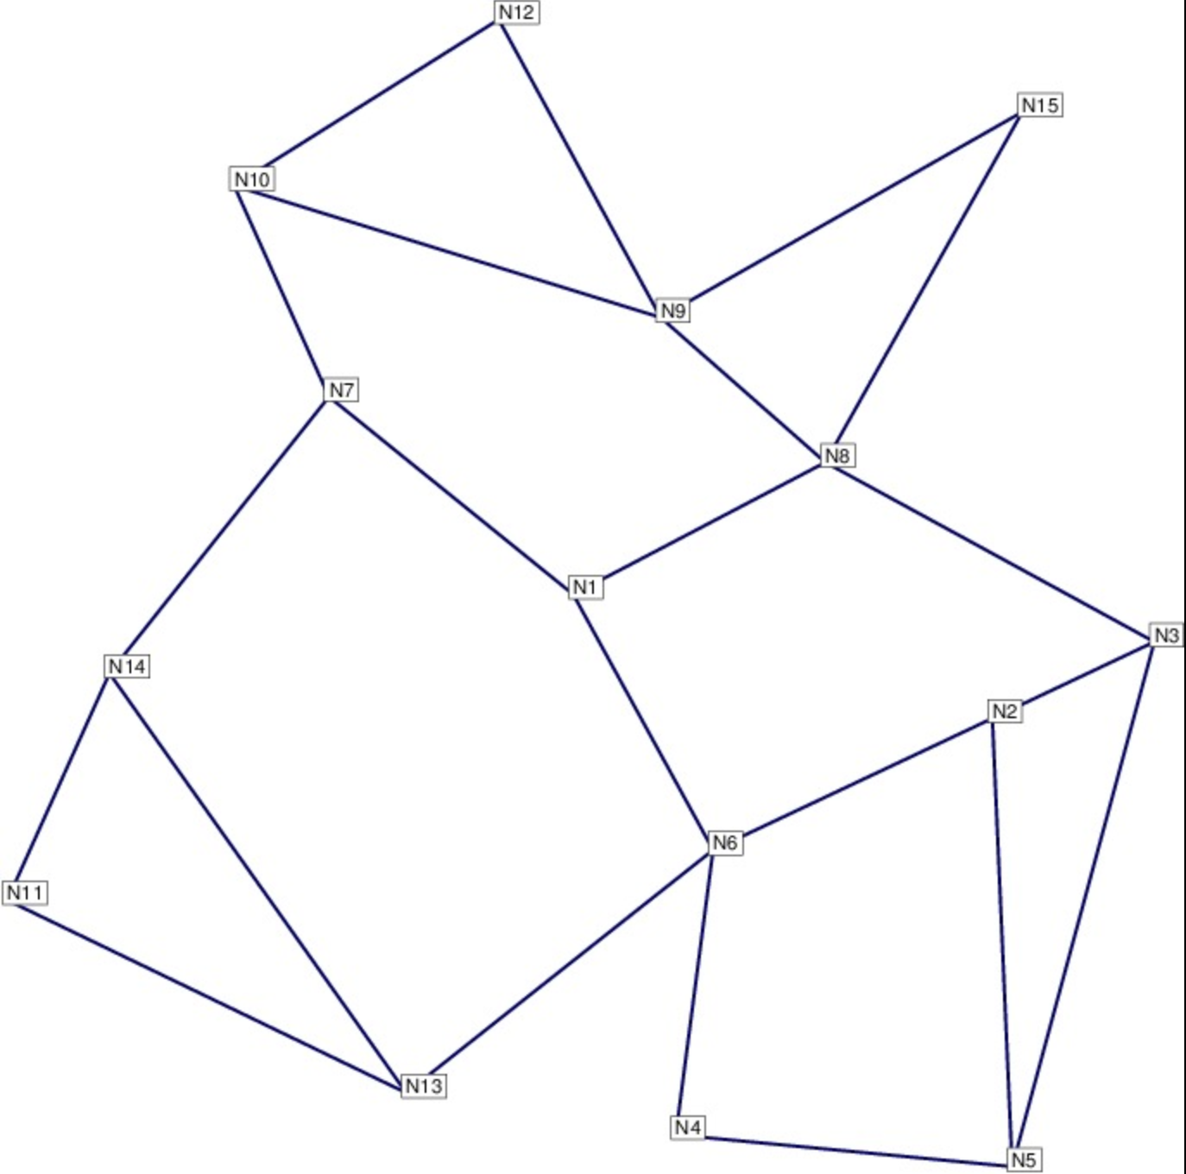
General Pipeline
Selection
Adjacent Matrix
Randomly Generation
Crossover
Envolution
Initial Population
- Gml files from sndlib
- Postmen = [p1, p2, p3, …, P]
Mutation
Evaluation
Fitness Solution
- Demands = [d1, d2, d3, … D]

Slide 8
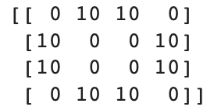
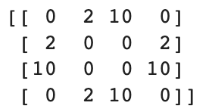

Dijkstra’ s Algorithm
Time Matrix
Dijkstra’s Algorithm
Topology
Node 1 Node 2 Node 3
Speed
Matrix
T[i]: The shortest time required to send a package to destination i.
Help to find the last finishing time of a new generated chromosome.

Slide 9
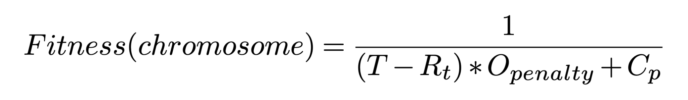
Fitness Evaluation

Slide 10
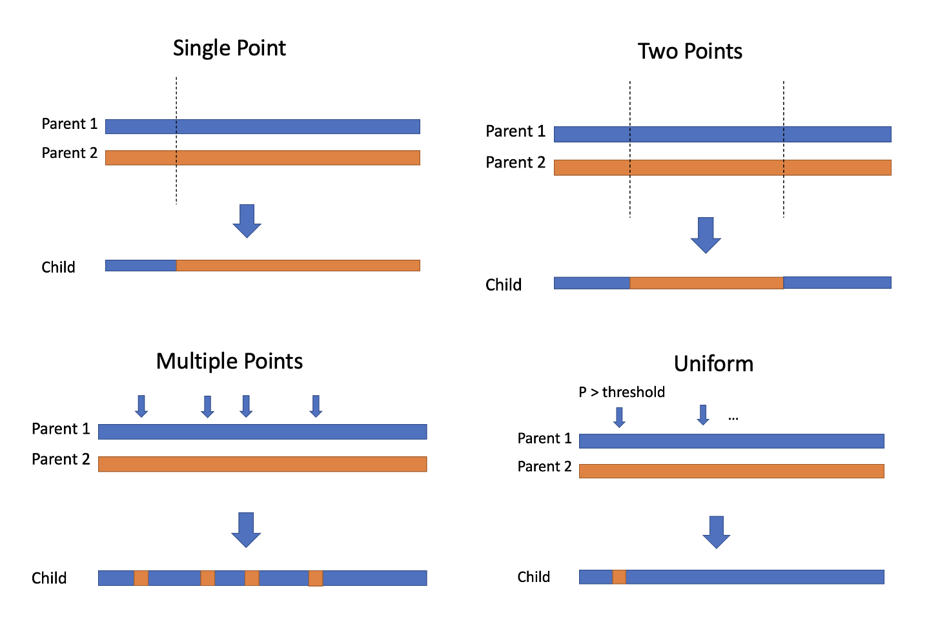
Crossover Methods

Slide 11
Mutation Operators
Insert
[2, 5, 7, 3, 6, 9, 1, 6, 0, 5, 4]
[2, 5, 6, 7, 3, 9, 1, 6, 0, 5, 4]
Inversion
[2, 5, 7, 3, 6, 9, 1, 6, 0, 5, 4]
[2, 5, 7, 6, 1, 9, 6, 3, 0, 5, 4]
Swap
[2, 5, 7, 3, 6, 9, 1, 6, 0, 5, 4]
[2, 5, 0, 3, 6, 9, 1, 6, 7, 5, 4]
Scramble
[2, 5, 7, 3, 6, 9, 1, 6, 0, 5, 4]
[2, 5, 7, 3, 6, 9, 1, 5, 0, 6, 4]

Slide 12
Termination
When the best chromosome in each iteration get the same fitness evaluation for a certain number of evolutionary. -> Converged
When the best chromosome has lower finishing time than the regulated time.
When maximum number of evolution has been reached.

Slide 13
Experiments & Results
Parameters | Value
Maximum Number of Generations | 1000
Population Size | 500
Mutation Rate | 0.05
Converge Generation Number | 20
Terminal Fitness | 0.05
Regulated Time | 30
Overtime Penalty | 1.5
Set up constant Parameters

Slide 14
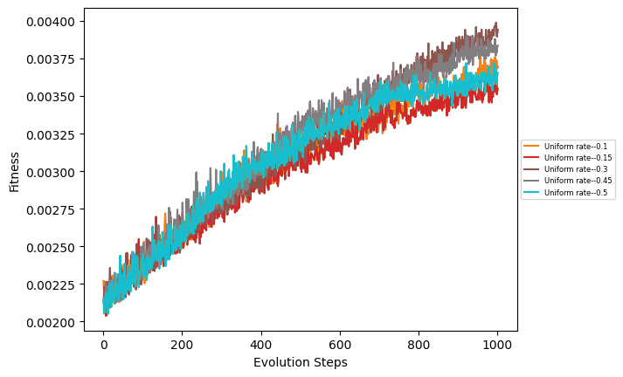
Experiments & Results cont'd
Get the Best Uniform Crossover Rate
Uniform Crossover Rate | Fitness
0.3 | 0.00394
0.45 | 0.00384
0.1 | 0.00370
0.5 | 0.00366
0.15 | 0.00355

Slide 15
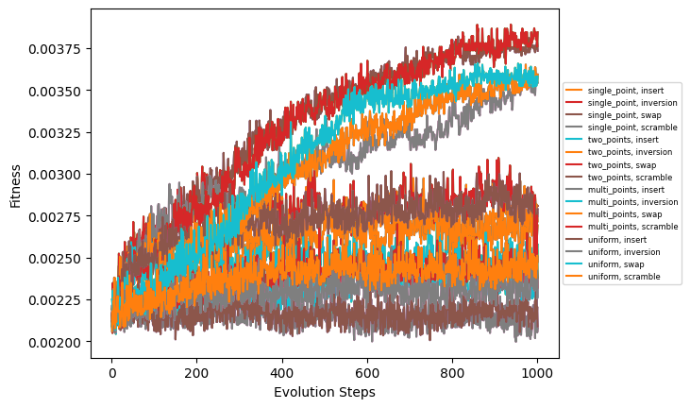
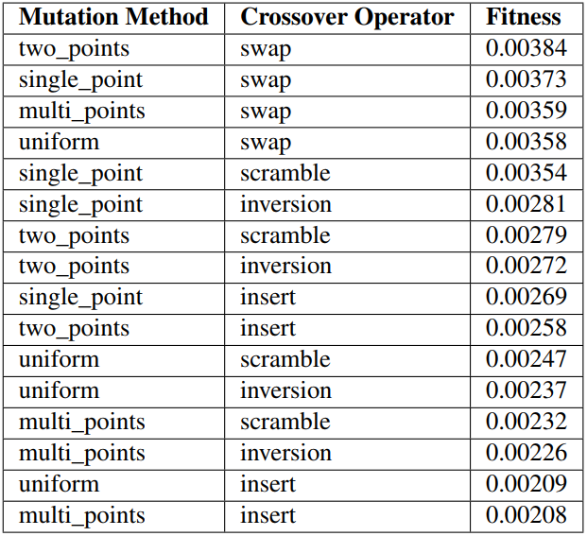
Experiments & Results cont'd
Get the Best Combinations

Slide 16
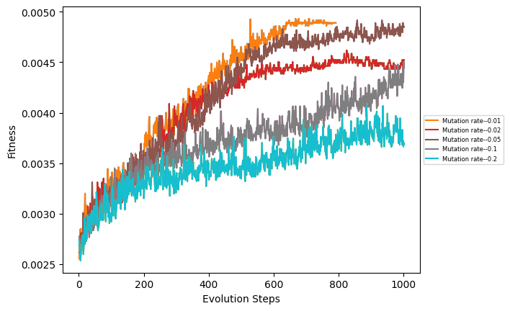
Experiments & Results cont'd
Get the Best Mutation Rate
Mutation Rate | Fitness
0.01 | 0.00483
0.05 | 0.00476
0.02 | 0.00448
0.1 | 0.00446
0.2 | 0.00355

Slide 17
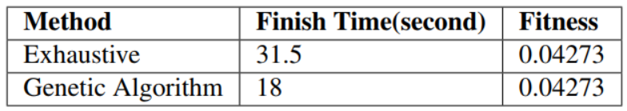
Experiments & Results cont'd
Test the feasibility of model
5 Nodes(Locations), 4 postmen, 11 demands

Slide 18
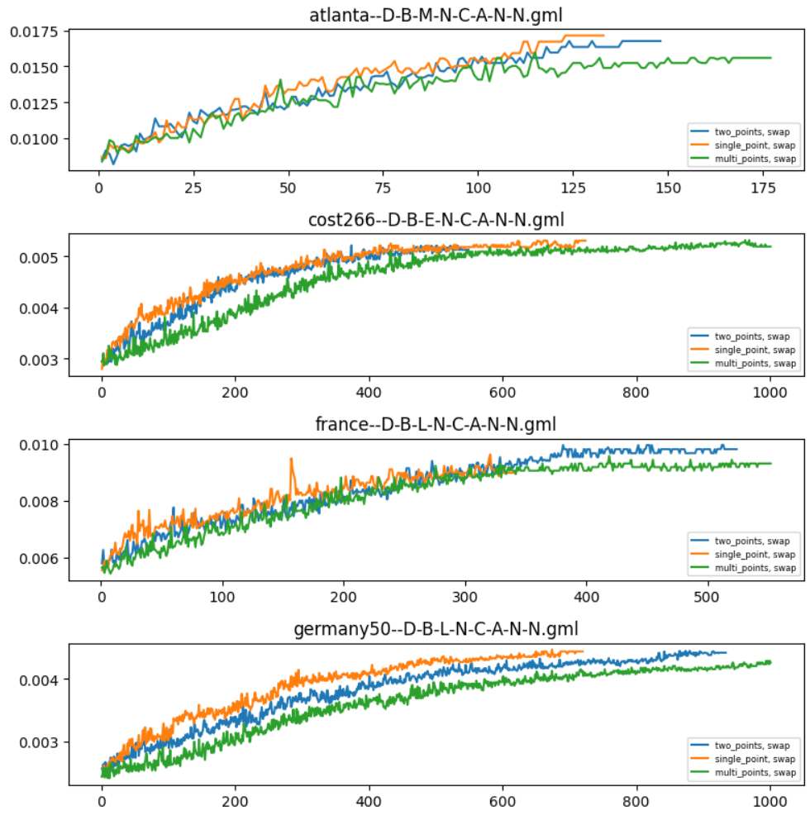
Experiments & Results cont'd
Test Best-Three Combinations
All graphs
Use parameters obtained in previous experiment.

Slide 19
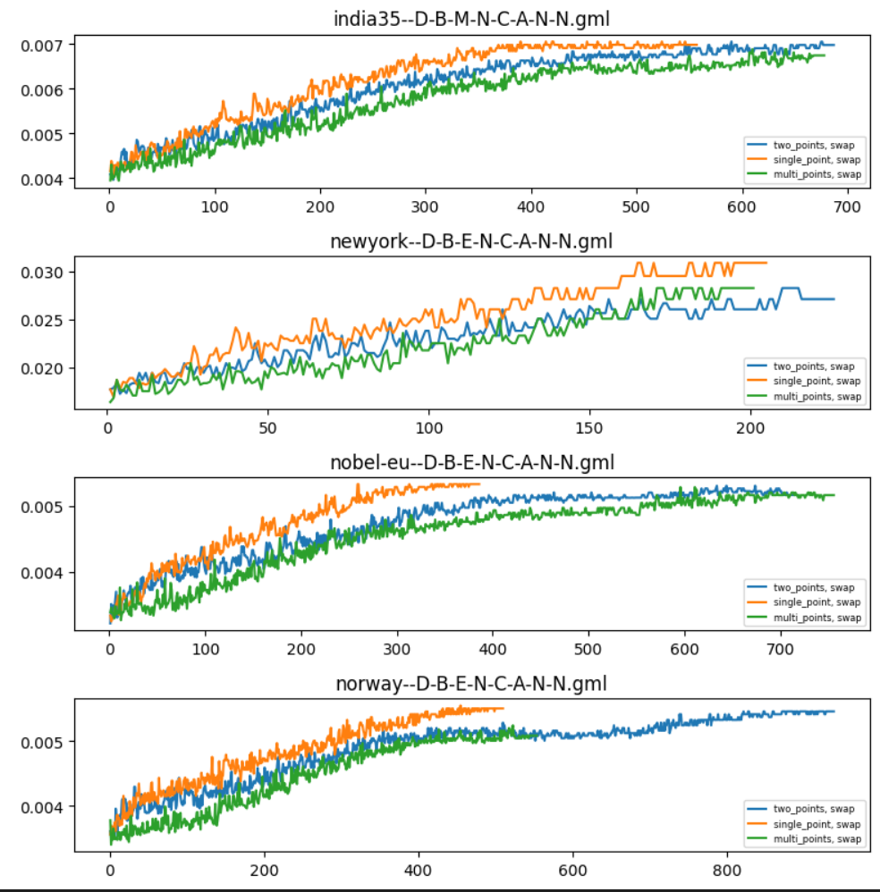

Slide 20
Conclusion
The problem could be solved efficiently using genetic algorithms.
Further research could be:
Investigate the integration of real-time traffic or weather conditions.
Introduce machine learning method such as Reinforcement Learning.

Slide 21
Thank You!

